Slide 1
The great theories
Media ethics

Slide 2
The great theories
Ethics, as we discussed before, is a reasoning process.
Two people may come to opposite conclusions and still argue rationally.
In our study of media ethics we try to examine how we go about forming those opinions.

Slide 3
The great theories
Even if you make decisions by instinct, those who work in the mass media must be able to rationally defend those opinions.
A framework and foundation in ethics will help us to do that.

Slide 4
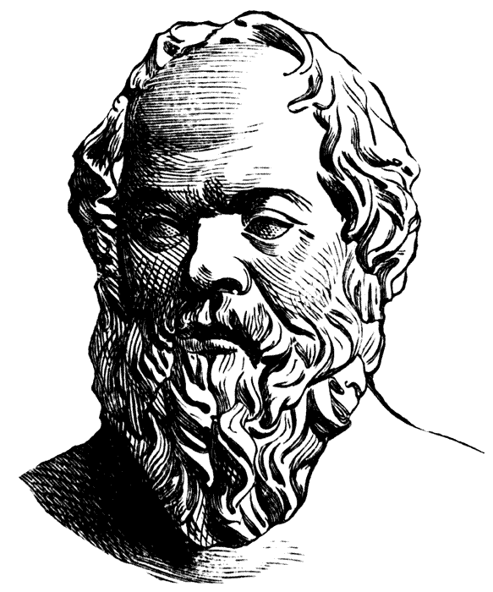
The great theories
We already noted that Socrates was the founder of ethical philosophy.
He though we could discover ethical guidelines by personal reflection.
He tried to help his students to develop their ideas through a question/answer discussion.

Slide 5
The great theories
Socrates seemed to place way too much faith in human ability to formulate guidelines on their own, given the world’s complexity.
Plato was Socrates’ student. He told us Soc existed, as the great man himself wrote nothing down.
Socrates would not get tenure in today’s universities!

Slide 6
The great theories
Plato said “the good” was independent of culture or opinion.
Virtue was the courage to uphold the good despite public opinion.
You would do something for “the greater good,” despite punishment or ridicule.
Many editors argue “the greater good” as a rationale for their decisions.

Slide 7
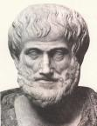
The great theories
Aristotle, Plato’s student, was more practical.
Aristotle said the means were important, and that the ends don’t justify the means.
Therefore, in the Heitz dilemma, he would argue against stealing, even if the ends were good.

Slide 8
The great theories
Aristotle offered the Golden Mean:
Correct behavior can be found between extremes.
For instance, courage is the middle ground between cowardice and foolhardiness.
Pride is a virtue, if between vanity and self-desecration.
The Golden Mean sounds a lot like the journalism virtue of “fairness.”

Slide 9
The great theories
The Golden Mean, for example, would tell us to ban tobacco ads from television, but not from magazines.
Some people find the Golden Mean vexing. For example, we ban ALL smoking on campus, not just from certain buildings.
And what about theft or murder? Slavery? The Golden Mean doesn’t seem easy to apply sometimes.

Slide 10
The great theories
Aristotle agreed.
He emphasized developing quality of character, so we could make the right decisions.
How? By habit. If you get used to making moral decisions, you do so automatically.
But that puts high expectations on the individual.

Slide 11
The great theories
Aristotle predated Christianity.
Christianity offers an alternate code: “love your neighbor has yourself.”
This means all actions should be based on respect for individual dignity.
People should not be used as a means to an end.

Slide 12
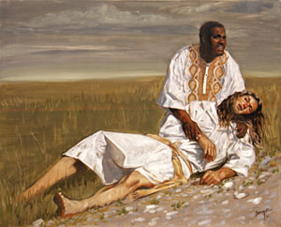
The great theories
As in the Parable of the Good Samaritan, people of all classes, all races, famous or rich, poor or obscure, should be treated with equal respect.

Slide 13

The great theories
Certainly this viewpoint applies to journalists who are likely to hold others up for scrutiny.
About 17 centuries later, Immanuel Kant weighed in with a new ethical standard:
Act in such a way that your decision could be made universal.

Slide 14
The great theories
Kant believed decisions should be made because they are right, not considering the consequences.
Kant called the the categorical imperative.
For example, always tell the truth, no matter the consequences.

Slide 15
The great theories
Kant also believed, as does Judeo-Christian ethics, that people should be treated with respect and autonomy, not a means to and end.
Still, we can see a problem with Kant’s imperative: what do you say to a friend whose new hair style is truly awful?

Slide 16
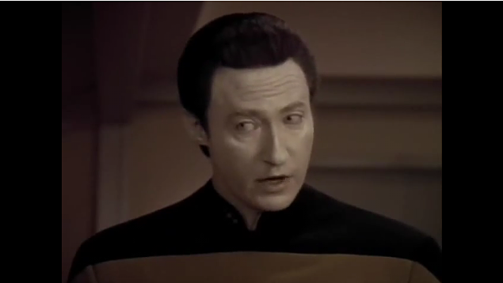
The great theories
Perhaps Kant would have found his greatest hero in Data, the character from “Star Trek: The Next Generation.” Data was incapable of lying, and incapable of emotion.
[http://www.youtube.com/watch?v=TgnUFan6iwg]

Slide 17
The great theories
Kant believed motives for an ethical decision was based on duty.
For example, if you avoided plagiarizing because you worried about getting caught, you would not be acting out of a sense of duty.

Slide 18
The great theories
Kant’s absolutism is hard to implement.
Duty-based philosophers today argue universal principles such as truth-telling should be obeyed—unless there’s a compelling reason not to.
Nevertheless, they believe consequences are not the primary factor.
The idea of duty is not very popular today.

Slide 19
The great theories
Jeremy Bentham and John Stuart Mill argued for consequences.
In the 19th century they created utilitarianism.
“Creating the greatest good for the greatest number.”
“Harm principle”: minimizing harm as much as possible.

Slide 20
The great theories
This philosophy argues that what’s important is the result. It’s a popular approach in the United States.
Reporters can argue using devious means to obtain information is all right: we can eavesdrop on a politician’s conversations, because the public has the right to know.

Slide 21
The great theories
“Greatest good for greatest number” is highly popular among media gatekeepers.
Editors argue in favor of publishing news that will harm a few, because it will help many.
Politicians also favor this philosophy. But it threatens the minority by forcing the “tyranny of the majority” on them.

Slide 22
The great theories
The United States Founding Fathers realized this, and so created in the Constitution rights that could not be taken away, even if the vast majority were opposed to them.
These are specified in the Bill of Rights. Below are the first five.

Slide 23
The great theories
Amendment 1 - Freedom of Religion, Press, Expression. Ratified 12/15/1791.
Congress shall make no law respecting an establishment of religion, or prohibiting the free exercise thereof; or abridging the freedom of speech, or of the press; or the right of the people peaceably to assemble, and to petition the Government for a redress of grievances.
Amendment 2 - Right to Bear Arms. Ratified 12/15/1791.
A well regulated Militia, being necessary to the security of a free State, the right of the people to keep and bear Arms, shall not be infringed.
Amendment 3 - Quartering of Soldiers. Ratified 12/15/1791.
No Soldier shall, in time of peace be quartered in any house, without the consent of the Owner, nor in time of war, but in a manner to be prescribed by law.
Amendment 4 - Search and Seizure. Ratified 12/15/1791.
The right of the people to be secure in their persons, houses, papers, and effects, against unreasonable searches and seizures, shall not be violated, and no Warrants shall issue, but upon probable cause, supported by Oath or affirmation, and particularly describing the place to be searched, and the persons or things to be seized.
Amendment 5 - Trial and Punishment, Compensation for Takings. Ratified 12/15/1791.
No person shall be held to answer for a capital, or otherwise infamous crime, unless on a presentment or indictment of a Grand Jury, except in cases arising in the land or naval forces, or in the Militia, when in actual service in time of War or public danger; nor shall any person be subject for the same offense to be twice put in jeopardy of life or limb; nor shall be compelled in any criminal case to be a witness against himself, nor be deprived of life, liberty, or property, without due process of law; nor shall private property be taken for public use, without just compensation.

Slide 24
The great theories
Egoist ethicists like utilitarianism. But they adjust it to “the greatest good for me.”
Many people reject ethical egoism out of hand. But let’s take a closer look. It’s actually quite popular in the United States. Many people are uncomfortable with that realization. [http://www.youtube.com/watch?v=7t4SHCSHoIg]

Slide 25
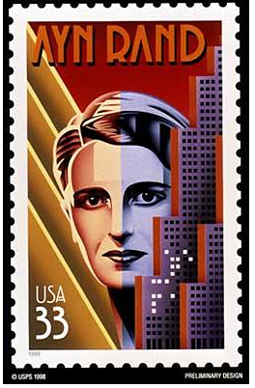
The great theories
Ayn Rand ( pronounced “eye-ann rand”) is considered a proponent of ethical egoism.
Many political conservatives find parts of this philosophy attractive.

Slide 26
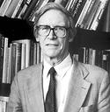
The great theories
John Rawls, a 20th -century philosopher, refined utilitarianism.
Like utilitarianism’s “harm principle,” Rawls advocated a decision that minimized harm to weakest groups.

Slide 27
The great theories
Rawls advocated his “original position.”
To achieve this, step behind a “veil of ignorance,” disregarding aspects such as age, sex, wealth, race, class, etc.

Slide 28
The great theories
This means that if you have a stake in the outcome of your decision, you step back to look at general principles beyond that.
This sets up a system of ethics based on equality.
No double standard should exist—unless you have a compelling and morally defensible reason to discriminate.

Slide 29
The great theories
For example, a television executive produces programming for a minority audience, even though it may be difficult to attract advertisers.
On the other hand, an editor could argue he discriminates in favor of material for a Native American population, because they have generally been underserved or ignored.

Slide 30
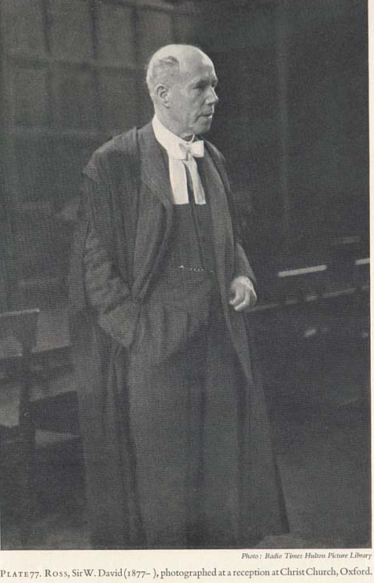
The great theories
Yet all these ethical approaches are quite general. We might be able to use more specific guidelines.
W.D. Ross offered some, in his The Right and the Good (1930).

Slide 31
The great theories
Ross sets up six “prima facie” duties, that is, apparent first claims on your ability to make a decision.

Slide 32
W.D. Ross’s duties
The first duty is based on previous actions. That is, when you make a promise, you incur a duty. You also have the duty to repair harm from a previous thing you have done.

Slide 33
W.D. Ross’s duties
The second duty rests on previous acts of others toward you. That is, gratitude.

Slide 34
W.D. Ross’s duties
The third duty rests on preventing the possibility of giving happiness NOT warranted to another person. That is, justice.

Slide 35
W.D. Ross’s duties
The fourth duty is acknowledgement that other beings in the world could better their condition based on our actions. That is, beneficence.

Slide 36
W.D. Ross’s duties
The fifth duty arrives from our ability to improve our own virtue, intelligence or pleasure. That is, self-improvement.

Slide 37
W.D. Ross’s duties
The sixth duty requires one to avoid harm to others, such as the Hippocratic Oath: “First, Do No Harm.”

Slide 38
The great theories
Progressivist ethics was promoted by Bertrand Russell and John Dewey earlier in the last century.
It posits that what’s right for you may not be right for me, even in similar circumstances.
This is fairly similar to ethical relativism.

Slide 39
The great theories
Related to ethical relativism is situational ethics.
Situationalists believe decisions should be made ad hoc, on a case-by-case basis.
A danger in this is the possibility of letting rationalization, prejudice or emotion sway the decision-maker.
Nevertheless, it is a popular ethical approach nowadays.

Slide 40
The great theories
Situational ethicists would argue against studying ethical standards.
In making decisions this way, we we rely on whatever we can from our past.
Our decisions as mass media practitioners will be difficult to defend based on such choices.

Slide 41
The great theories
So in short except for ethical relativism, we can sort ethical theories into three groups:
deontological;
teleological;
virtue-based.

Slide 42
The great theories
Deontological, from Greek deon, or duty, is non-consequentialist.
Our behavior should be based on certain universal principles.

Slide 43
The great theories
Is Robin Hood a hero or a villain? Villain, would say the deontologists, because stealing is never justified.
Could a reporter use deception to uncover a good story? Could a producer use sex and violence to gain more viewers? NO.
Not surprisingly, this approach is unpopular among media practitioners.

Slide 44
The great theories
On the plus side, deontological systems do set up concrete rules, few exceptions, and predictable ethical choices.
The problem is deciding when to make exceptions.

Slide 45
The great theories
Teleological, or consequence-based systems, asks not if an approach is right or wrong, but if it leads to good consequences.
This means “greatest good for greatest number.”
In media, we call it “public’s right to know,” or “public interest.”

Slide 46
The great theories
But teleological systems also emphasize minimizing harm.
For example, we might publish DUIs, but we wouldn’t include pictures and details about the persons so charged—even if it would attract more readers.

Slide 47
The great theories
Teleological systems offer more flexibility.
But they do rest on our ability to predict consequences.
They also may reflect the tyranny of the majority. For example, “greatest good for greatest number” would suggest no television programming for minorities.

Slide 48
The great theories
Virtue theories set up standards of behavior.
Developing quality of character will produce ethical behavior. Hard to do!
The Golden Mean does offer a good compromise. But sometimes compromise is not possible. Sometimes there is no middle ground.
“Love your neighbor” may not give just treatment to those who deserve it.

Slide 49
The great theories
Can we base our ethics on principle? Or are we all egoists, as Ayn Rand might have said? [http://www.youtube.com/watch?v=HCHu1E0ca4E]
Is the “Joey” character on “Friends” right? Or…. [http://www.youtube.com/watch?v=irTolXyHzcI&feature=related]

